Slide 1
Change Your Water…
Change Your Life!
www.HumanBodyworks.com/water

Slide 2
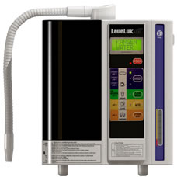
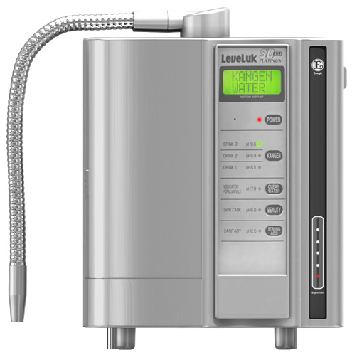
Today we are going to talk about a special water called Kangen Water.
It comes from a device made by a Japanese company called, Enagic (rhymes with Magic.)
Enagic® Flagship Product
SD 501 / SD 501 Platinum

Slide 3
Why Don’t People Drink Enough Water?
It doesn’t taste good.
I don’t like the way it feels.
It sloshes around in my belly.
It is hard to drink that much.
I have to force myself.
www.HumanBodyworks.com/water

Slide 4
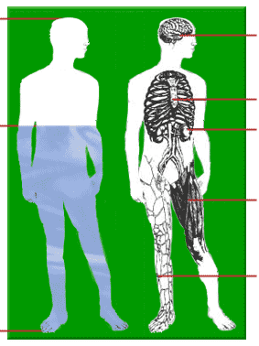
We Are Water Beings!
100%
Brain 80.5%
We are
70–75% Water
Bone 13%
75%
Kidney 82.7%
Muscle
75.6%
What is the quality of your 75%?
Blood
90.7%
0%
www.HumanBodyworks.com/water

Slide 5
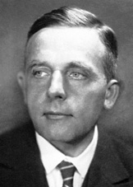
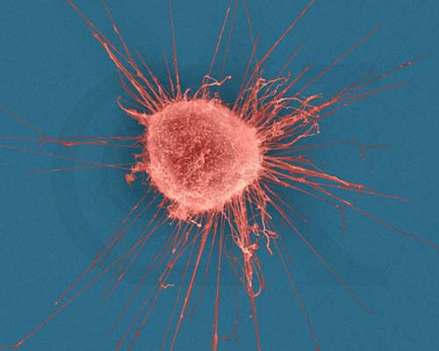
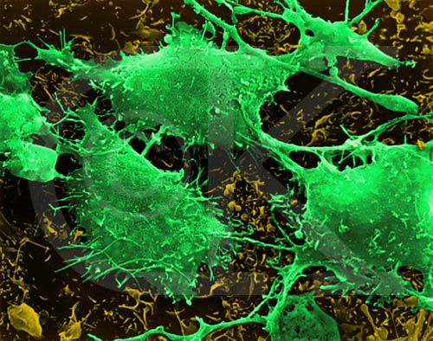
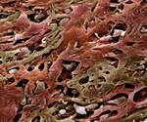
Dr. Otto Warburg
1931 Nobel Prize Winner in Physiology
For Discovering The Root Cause of Cancer
Cancer cells grow
in an ACIDIC environment
In 1940, the incidence of cancer in the U.S. was 1 in 16.
Today it is 1 in 3.
The leading cause of death in children ages 14 years or younger is cancer.
Breast Cancer Cell
Brain Cancer Cells
Lung Cancer Cells
Cancer cannot survive
in an ALKALINE environment
www.HumanBodyworks.com/water

Slide 6
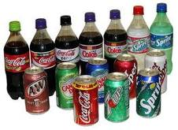
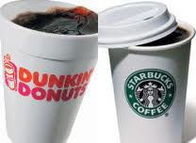
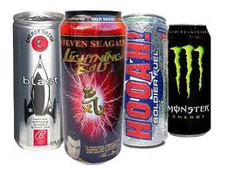
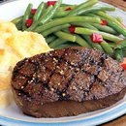
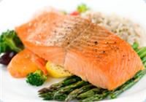
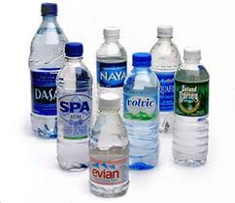
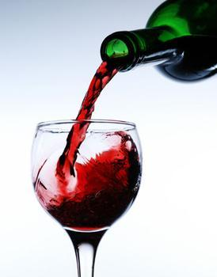
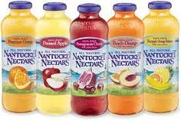
Consuming Acidic Foods and Beverages Drains Our Alkaline Buffers
REDUCED
CALCIUM
MAGNESIUM
POTASSIUM
SODIUM
CREATES
ACIDOSIS
www.HumanBodyworks.com/water

Slide 7
Dr. Theodore Baroody
“The countless names attached to illnesses do not really matter. What does matter is that they all come from the same root cause…
too much tissue acid waste in the body!”
F. Batmanghelidj, MD
www.HumanBodyworks.com/water

Slide 8
FDA Disclaimer These statements and products have not been evaluated by the FDA. Please note that this presentation is not intended to treat or cure any disease, nor should any of the subject matter be taken as medical advice.
www.HumanBodyworks.com/water

Slide 9
In the 1950s, scientific research was conducted in several unique locations around the world.
For thousands of years these places have maintained legendary status as a natural source for “Miracle Water.”
● Lourdes, France ● Nordenau, Germany
● Tlacote, Mexico ● Delhi, India
The “Miracle Healing Water”
at each location had one thing in common:
An Abundance of Active Hydrogen,
also known as Alkaline Water.
www.HumanBodyworks.com/water

Slide 10
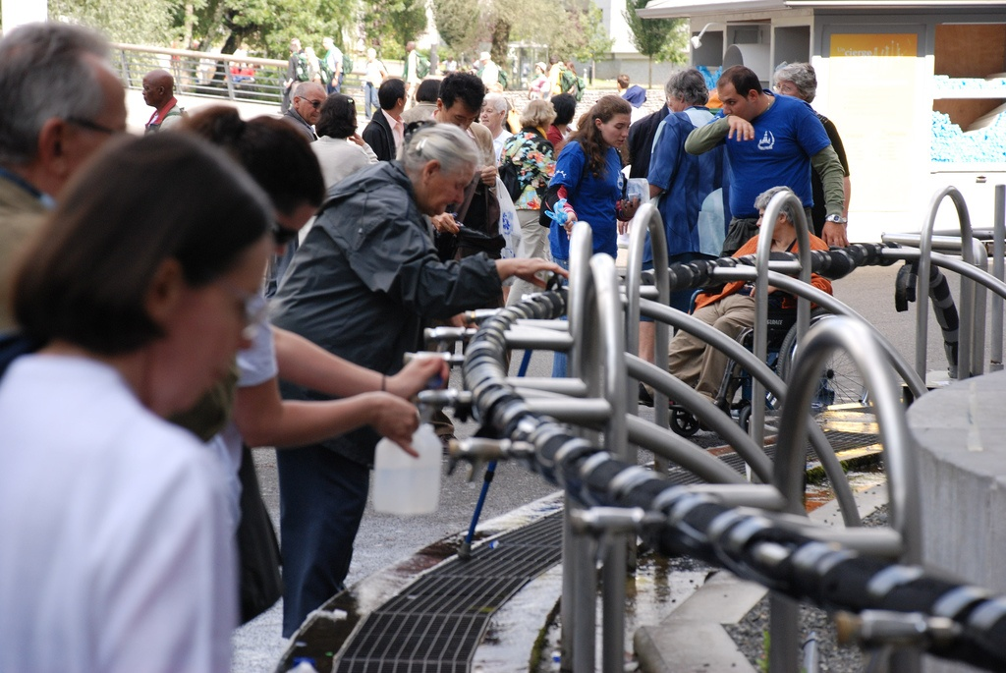
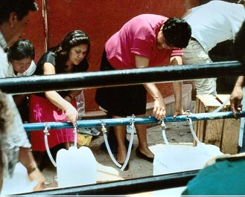
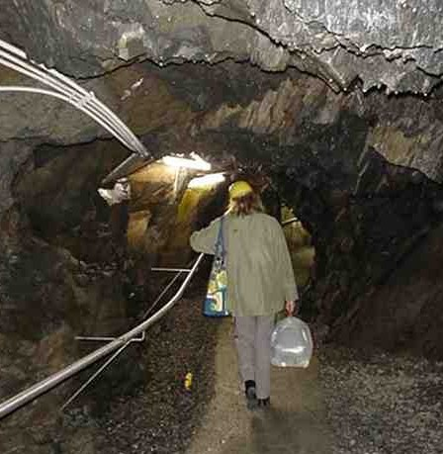
Miracle
Water
Holy Water – Lourdes, France
Tlacote, Mexico
“Wonder Water” – Nordenau, Germany
www.HumanBodyworks.com/water

Slide 11
www.HumanBodyworks.com/water

Slide 12
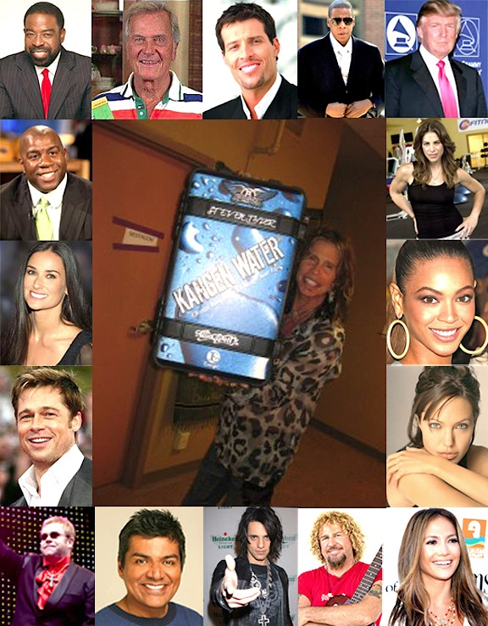

Slide 13
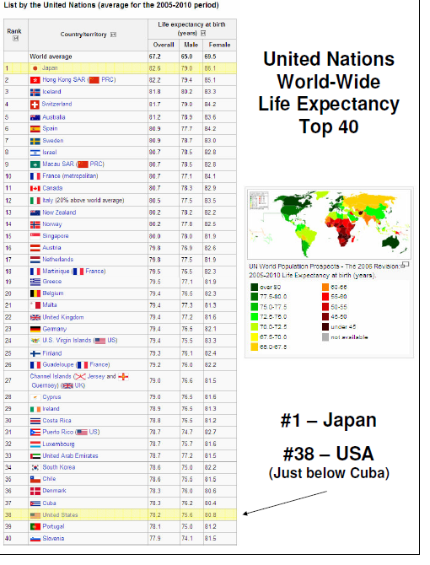
Japan is #1
Cuba is #37
USA is #38
www.HumanBodyworks.com/water

Slide 14
Facts
57% of all pain killers consumed in the world are consumed in the United States.
Two thirds of all prescription drugs produced in the world are consumed in the United States.
What does that tell us?
That the United States is filled with drug addicts.
Unfortunately, most of them are Senior Citizens.
All drugs are highly acidic.
www.HumanBodyworks.com/water

Slide 15
Kangen Water Demonstration
I believe that this is the missing link to
Health and Longevity.
This is the next Megatrend.
What you see here may shock and surprise you.
Remember
Your mind is like a parachute
It only works when it is open!
www.HumanBodyworks.com/water

Slide 16
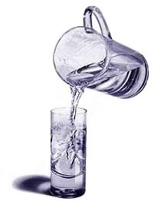
Three Kangen Water® Properties
Anti-Oxidant
Alkaline
Micro-Clustered
www.HumanBodyworks.com/water

Slide 17
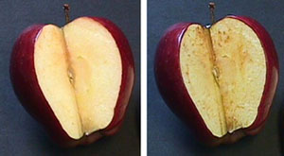
1. Anti-Oxidation
Oxidation = The “Rusting” Process
Living Tissue + Oxidation = Sickness & Aging
KANGEN™ Breakthrough Water Technology
Anti-Oxidation ♦ Anti-Inflammatory ♦ Anti-Aging
(Cut apple after several minutes)
www.HumanBodyworks.com/water

Slide 18
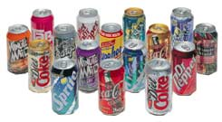
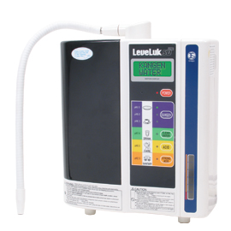
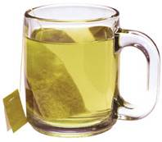
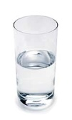
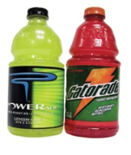
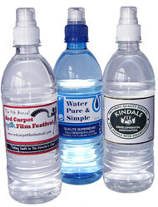
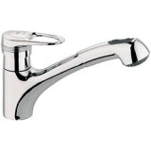
1. Anti-Oxidation
Oxidation
Reduction
Potential
- ORP (mv)
+ ORP (mv)
-400 -300 -200 -100 0 +100 +200 +300 +400
Soda
Green Tea
Sports drinks
KANGEN™
WATER
Purified R.O. Distilled Water
Vitamin C
Tap Water
www.HumanBodyworks.com/water

Slide 19
“…if free radicals are produced in the DNA, the DNA becomes transformed and it becomes mutated. Mutated transformed DNA will produce cancer, leukemia, and lymphoma. Diabetes, kidney problems, liver problems, almost every disease is related to the damage caused by these free radicals. If we remove the damage we are causing ourselves, all these diseases can be prevented.”
Dr. Hari Sharma, M.D.
Author of Freedom From Disease
Cancer Researcher for 22 years
Professor Emeritus, Pathology Department
Ohio State University College of Medicine
www.HumanBodyworks.com/water

Slide 20
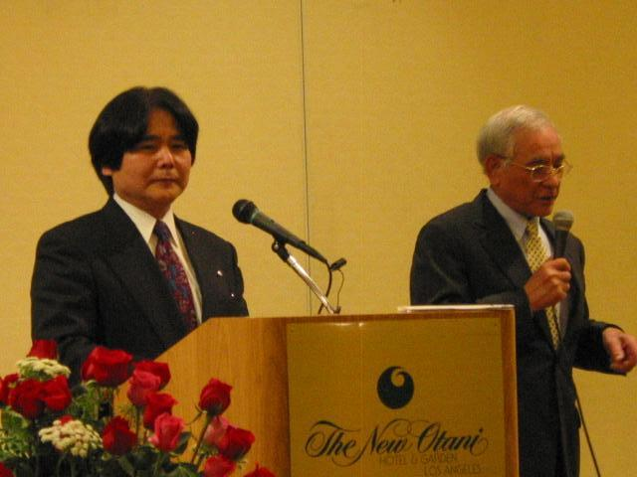
An Example Of What Oxidization Will Do To Your Body
They are the same age!
Enagic CEO
Hironari Oshiro
Enagic USA Business Advisor
www.HumanBodyworks.com/water

Slide 21
2. Alkalinity
Acid
0
ACID
Neutral
7
ALKALINE
Alkaline
14
CANCER = Acidic Environment
SICKNESS
Acidic Food & Drink
Emotional Stress
Normal
pH
HEALTH
Kangen Water®
Positive Spirit
www.HumanBodyworks.com/water

Slide 22
3. Water Molecule Clustering
Tap & Bottled Water
Kangen Water®
5 to 6 Molecules
Micro Clusters
Small Water
Super absorption by the cells
13 to 90 Molecules
BULK Clusters
Limited absorption by the cells
www.HumanBodyworks.com/water

Slide 23
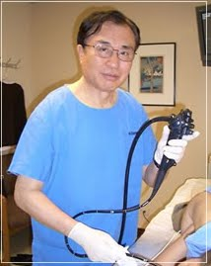
Dr. Hiromi Shinya, M.D. Ph.D.
Professor of Surgery at Albert Einstein College of Medicine
Chief of the Endoscopy Dept. at Beth Israel Medical Center
“Kangen Water ™ is considered the very best drinking water because of its incomparable powers of hydration,
detoxification and
anti-oxidation.“
Dr. Hiromi Shinya
The Enzyme Factor
page 159
www.HumanBodyworks.com/water

Slide 24
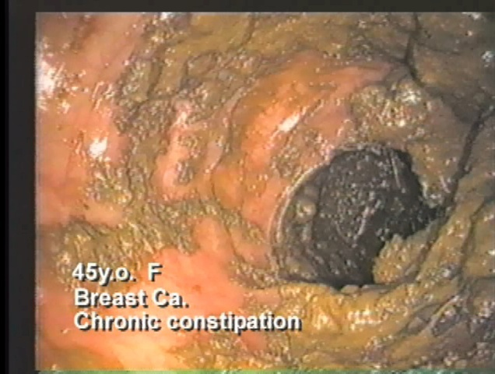
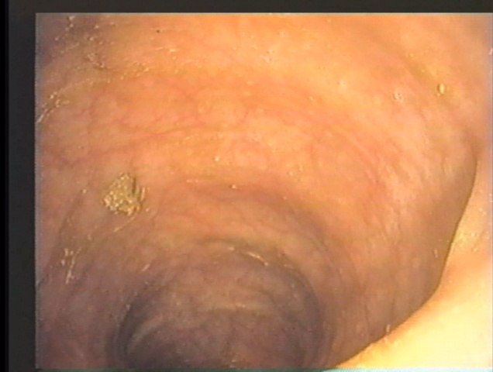
BEFORE
COLON of a 45 year old female with Breast Cancer and Chronic Constipation After Two days of Prep.
AFTER
3 Months After Treatment
www.HumanBodyworks.com/water

Slide 25
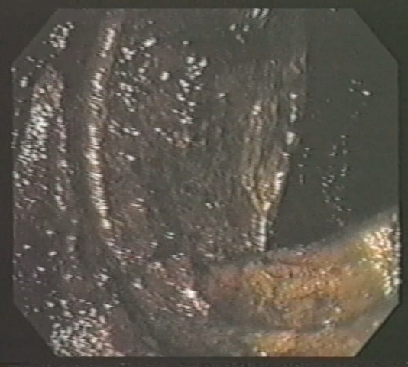
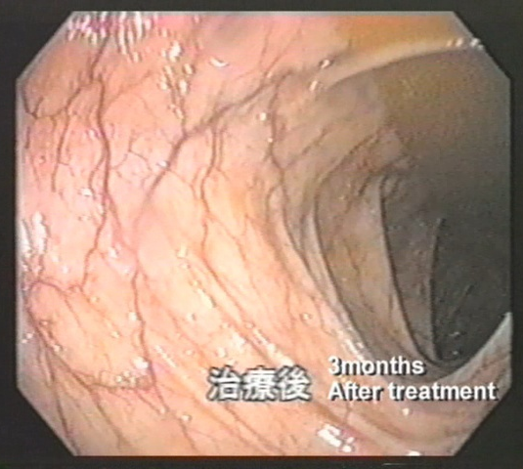
BEFORE
This is a colon of a 65 year old female,
Cigarette Smoker with Breast Cancer.
AFTER
3 Months After Treatment
www.HumanBodyworks.com/water

Slide 26
“Alkaline Water…
has become the most
important advancement
in health care since
Penicillin.”
Dr. William Kelly College of Metabolic Medicine Author of Cancer Cure
www.HumanBodyworks.com/water

Slide 27
Do you suffer from…?
Acid-reflux • High-blood pressure • High cholesterol
Arthritis • Gout • Chronic fatigue
Diabetes • Osteoporosis • Ulcers
Constipation • Heart disease • Cancer
If you answered “Yes” to one or more of the above
your body may be too ACIDIC!
www.HumanBodyworks.com/water

Slide 28
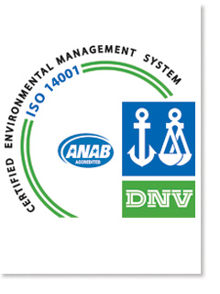
Enagic® Was Green
Before Green Was Popular!
We’ve talked about our physical health, now let’s talk about the health of our beautiful planet.
Our philosophy is Fill, Re-Fill, Re-Use.
Enagic was awarded ISO Certification. Our business practices help protect the environment.
www.HumanBodyworks.com/water

Slide 29
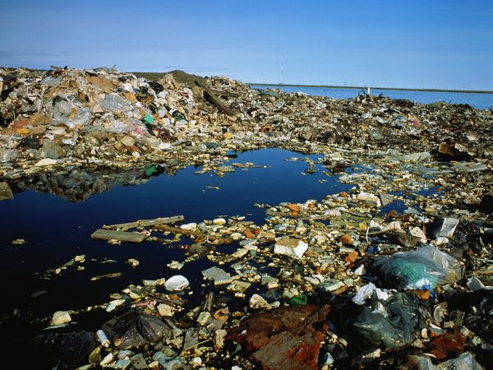
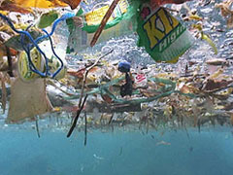
What Are We Doing?
Do you know how many plastic water bottles are thrown away each day in the U.S.?
Less than 20% of plastic water bottles get recycled.
It takes 1,000 years to break down 1 water bottle.
60 Million!
Where does it go?
www.HumanBodyworks.com/water

Slide 30
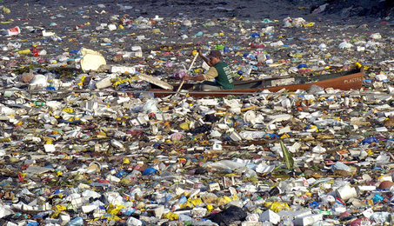
www.HumanBodyworks.com/water

Slide 31
Enagic® Flagship Product
SD 501
SD 501 Platinum
Given the Seal of Approval and Endorsed by the
Japanese Association of Preventative Medicine For Adult Disease
An independent body of 6,500 medical doctors.

Slide 32
7 Different Waters by SD501 A Complete Household System!
11.5 Strong Kangen
9.5 Kangen Water
9.0 Kangen Water
8.5 Kangen Water
7.0 Clean Water
6.0 Beauty Water
2.5 Strong Acidic
Does your water filter
do this?
www.HumanBodyworks.com/water

Slide 33
There are No Independent Water Ionizer Reviews Online
The knock-offs say they are twice as good for half the price.
Solid Plates vs Mesh Screens.
They add a second filter, which adds inorganic minerals to ionize the water, because they can’t do it with electricity alone. Your body does not utilize inorganic minerals.
www.HumanBodyworks.com/water

Slide 34
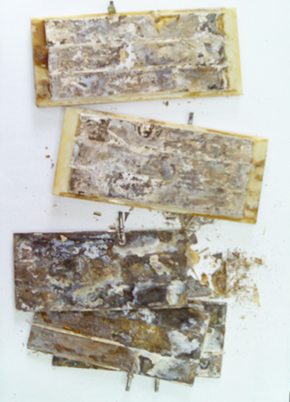
The Difference is Clear
Mesh Screen Technology of the Knock-offs
Cannot be cleaned or serviced.
The mesh screens break down.
www.HumanBodyworks.com/water

Slide 35
The Difference is Clear
Large
Plates
3
5
7
Serviceable Plates
Enagic SD501
7 Large Solid Titanium Plates Dipped in Medical Grade Platinum
450% Larger Surface Area than the Knock-offs
230 Watts of Continuous Power = 270% More Powerful Electrolysis
www.HumanBodyworks.com/water

Slide 36
Why Ionized Water Cannot be Sold in Stores
The anti-oxidant/electrical charge and micro-clustering wears off after 48 hours.
The alkalinity wears off after 5 days.
To maximize your results and benefits, drink Kangen Water fresh from your machine everyday.
www.HumanBodyworks.com/water

Slide 37
LeveLuk SD501
Health • Beauty • Hydration • Cleaning
$3,980
$4,280
Either
machine
comes to
less than
75¢
per day
SD 501
SD 501 Platinum
5 YEAR WARRANTY / 15 – 20 YEAR LIFE SPAN
www.HumanBodyworks.com/water

Slide 38
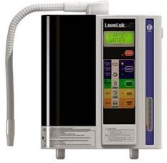
The Benefits Far Outweigh the Cost
$1/day (with cleanings!)
Fresh Water
Antioxidant/Healing
Alkalizing
Micro-Clustered
Super Hydration
$5+/day (1¢/10,000%)
Old Water
Oxidizing/Damaging
Acidifying
Bulk-Clustered
Poor Hydration
www.HumanBodyworks.com/water

Slide 39
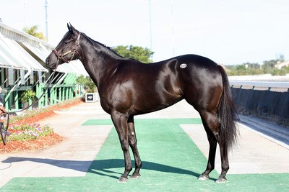
A Million Dollar Thoroughbred?
Now That You Know How Bad
Your Tap and Bottled Water Are
Would You Give It To:
www.HumanBodyworks.com/water

Slide 40
A Puppy Dog?
www.HumanBodyworks.com/water

Slide 41
A Baby?
www.HumanBodyworks.com/water

Slide 42
Why Would You Put Bad Water
Into Your Own Body?
Doesn’t Your Family
Deserve the Best?
www.HumanBodyworks.com/water

Slide 43
Cost A Concern?
Here’s the Good News:
Our Referral Program!
If this works half as good as we say it does, would you keep it a secret or would you share it with people you care about?
If someone has acid reflux, the gout, diabetes, etc. wouldn’t you want to help them?
That’s how our referral program works.
Share and get paid for it.
www.HumanBodyworks.com/water

Slide 44
How Referrals Offset Your Cost
Do you think that over the next 6 months you can find 3 people that can use the benefits of drinking Kangen Water?
That alone will recoup $1,140 of your money.
www.HumanBodyworks.com/water

Slide 45
7 Reasons Why You Can’t Afford NOT to Buy an SD501
Improved health for you and your family
Healthier than bottled and tap water
Cheaper than bottled water
Save money on household cleaners/chemicals
$4,000 tax write-off as a home-based business
Can cut your taxes by up to 30 – 50% every year
Earn extra money through our referral program for college, weddings, vacation, retirement, etc.
www.HumanBodyworks.com/water

Slide 46
All You Have to Decide is
which machine would look better
in your kitchen?
SD 501
SD 501 Platinum
www.HumanBodyworks.com/water

Slide 47
Payment Options for SD501
Purchase your machine TODAY and receive a 30 day money back guarantee.
There is NO financial risk on your part.
Pay In Full with a Credit Card.
or
Use one of our several 3rd party finance companies, starting for as little as $44.00 per month, no interest for twelve months for people that qualify.
www.HumanBodyworks.com/water

Slide 48
You Have Three Choices
I got it! This makes sense to me. I’m ready to get started. I want to purchase my machine today.
I would like to try the water while I’m getting my finances together.
Thanks, but no thanks. I don’t believe a word you said. I don’t believe my eyes. I’m going to continue drinking that same old, expensive, dead, acidic water.
What are you?
1, 2 or 3?

Slide 49
So You Still Want To Think About It?
What will you know tomorrow,
that you don’t already know today?
www.HumanBodyworks.com/water

Slide 50
Your Spouse Not Here Tonight?
Don’t even try to explain what
you saw here tonight.
Don’t mention the price.
Or you will be sleeping outside the house tonight!
www.HumanBodyworks.com/water

Slide 51
Show of Hands…
How many of you enjoyed tonight’s presentation?
How many of you would like
your family and friends
to see this demo at your home?
www.HumanBodyworks.com/water

Slide 52
We are looking for
Water Warriors
to help us spread the word.
Host a water demo and we will show you how to offset your cost.
www.HumanBodyworks.com/water

Slide 53
I hope I did a good enough job
of explaining the benefits of
Kangen Water
that will help you make the decision to invest in the health of your family.
www.HumanBodyworks.com/water

Slide 54
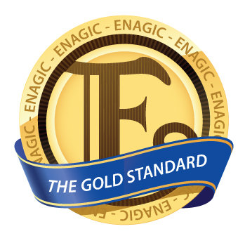
Short Break
For those of you interested in looking at the business opportunity with Enagic
please stay after the break.
Thank you for joining us today.
Change Your Water…Change Your Life!

Slide 55
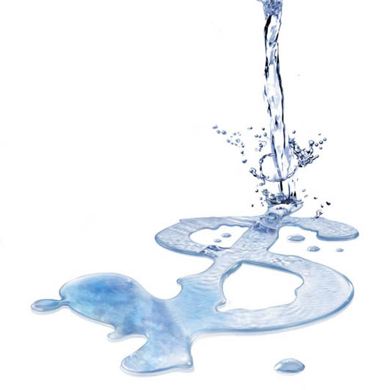
Enagic® Company
Overview

Slide 56
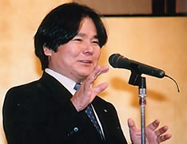
Our Corporate Philosophy
is Based on 3 Basic Principles
Realizing true physical health
Realizing true financial health
Realizing true mental/metaphysical health
(What we like to call, a peace of mind.)
Mr. Hironari Oshiro
Founder
President & CEO
Enagic® U.S.A., Inc.

Slide 57
Enagic® is The Gold Standard
Used in the Top Japanese Hospitals.
Certified as a medical device in Japan and Canada.
Offices in Los Angeles, New York, Chicago, Honolulu, Orlando; Canada, Asia, Europe, Mexico and Australia.
Member of the D.S.A. (Direct Selling Assoc.).
An Accredited Member of the Better Business Bureau with an A Rating.

Slide 58
Enagic® is The Gold Standard
Privately held company, established in 1974.
Enagic® purchased the water ionizer technology from the Sony Corporation.
In 1987, the Ministry of Health, Labor and Welfare (the Japanese FDA), certified Enagic’s® water ionizers as a medical device.
An Original Equipment Manufacturer (OEM); Enagic® makes every part in their machines – nothing is outsourced.

Slide 59
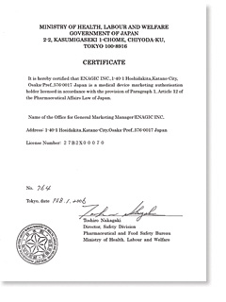
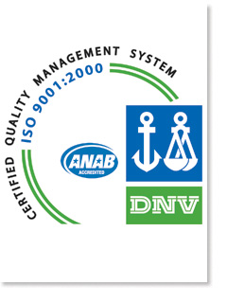
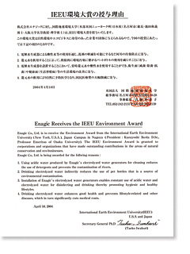
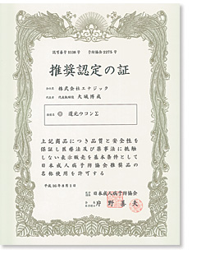
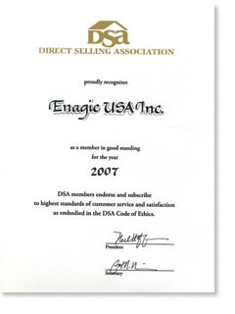
Enagic® is The Gold Standard
Numerous Awards and Documented Recognition

Slide 60
Enagic® is The Gold Standard
WQA Gold Seal NSF / ANSI Certification
Enagic® is the ONLY ionizer manufacturer in the world with this coveted certification!

Slide 61
Enagic® Patented
Compensation
Plan

Slide 62
Let’s Start Your Business
We Turn Liquid into Liquidity.
When you purchase a machine, the business comes with it free!
No Monthly Qualifications.
No Annual Renewals.
No Sales Quotas.
No Auto-Ship.
Enagic® Pays Daily!
SD 501

Slide 63
]
Enagic® Business Model – Direct Sales
MLM vs. Direct Sales Understanding the Difference
MLM – Pyramid
Direct Sales – Over & Down
Less than 1/10th of 1 % ever complete the pyramid.
Most people in MLMs spend more money than they make.
They have a garage full of product.
They become a member of the NFL Club – the No Friends Left club.
YOU
5
YOU
2 5
1 2 5
6 2 5
3 1 2 5

Slide 64
]
Enagic® Patented Compensation Plan
Enagic does no advertising, so the money that they would have spent on advertising goes to the distributors.
Each machine has a point value.
For SD501: 1 Point = $285
$235 Commission + $50 Special Bonus
Enagic pays out 8 points per machine to the sales force.
A maximum of 6 points is paid to a distributor.
1
Point
1
Point
1
Point
1
Point
1
Point
1
Point
1
Point
1
Point
Direct Sales In Each Rank
1A
2A
3A
4A
5A
6A
$285
$570
$855
$1140
$1425
$1710

Slide 65
]
Enagic® Patented Compensation Plan
How to advance in rank
1A
1A
2A
3A
4A
5A
6A
$285
$285
$570
$855
$1140
$1425
$1710
1st Sale
Direct
2nd Sale
Direct
3rd Sale
Direct
Next
Direct
Sale
Next
Direct
Sale
Next
Direct
Sale
Next
Direct
Sale
10 Group Sales - Direct or Indirect
Direct Sale is made by You
Indirect Sale is made by Others within your 8 points
20 Group Sales - Direct or Indirect
50 Group Sales - Direct or Indirect
100 Group Sales - Direct or Indirect

Slide 66
Return on Investment
Where can you get into a business for $4,000 and earn $30,000 – $150,000 in the first year?
How do you recoup your $4000?
I’m going to help you get 3 customers = $1140.
You and I are going to help those 3 customers get 3 customers each.
Total return on investment is $4560.
It’s that simple.
www.HumanBodyworks.com/water

Slide 67
What The Top Earners are Doing
Share Your Story and Share Kangen Water®
Educate and Inform
Live Demos
or DVD
Follow-Up
Duplicate
Simplicity is the Key!

Slide 68
The Reasons People Are Succeeding
All The Lights Are Green!
Simple & Duplicatable System
Target Market: Everybody!
High-Power Overrides & Bonuses
Phenomenal Compensation Program
Puppy Dog Marketing Approach
Outstanding Products
Rock Solid Company
New (Great Timing)

Slide 69
Join a Winning Team
One Team. One Dream. One System.
You’re in business for yourself, but not by yourself.
We provide training and support.
Almost every day of
the week, there is a
presentation like this that you can send your prospects to.

Slide 70
Payment Options for SD501
Purchase your machine TODAY and receive a 30 day money back guarantee.
There is NO financial risk on your part.
Pay In Full with a Credit Card.
or
Use one of our several 3rd party finance companies, starting for as little as $44.00 per month, no interest for twelve months for people that qualify.
www.HumanBodyworks.com/water

Slide 71
Are You Ready
to Get Started?

Slide 72
This Concludes Today’s Presentation
Get back with the person who invited you here.
Thank you for joining us today.
Change Your Water…Change Your Life!

